Slide 1






Multimodal Sentiment Analysis based on facial, vocal, and textual inputs Name: Osama Al-Attia ID: 190720926 Supervisor: Dalia Senvaityte MSc Computer Science

Slide 2
Problem statement:
Enhance machine's ability to predict human emotion more precisely.
Give robotics more features for easier integration in society like waitering robots.
Apply mixed emotion to the set of predictions and consider the complexity of human emotions.

Slide 3

Why:
Having robots that does not analyse the situations ”including sentiment situations” can be frustrating.
If we increase the precision if we can get a better experience in every platform that need it.

Slide 4
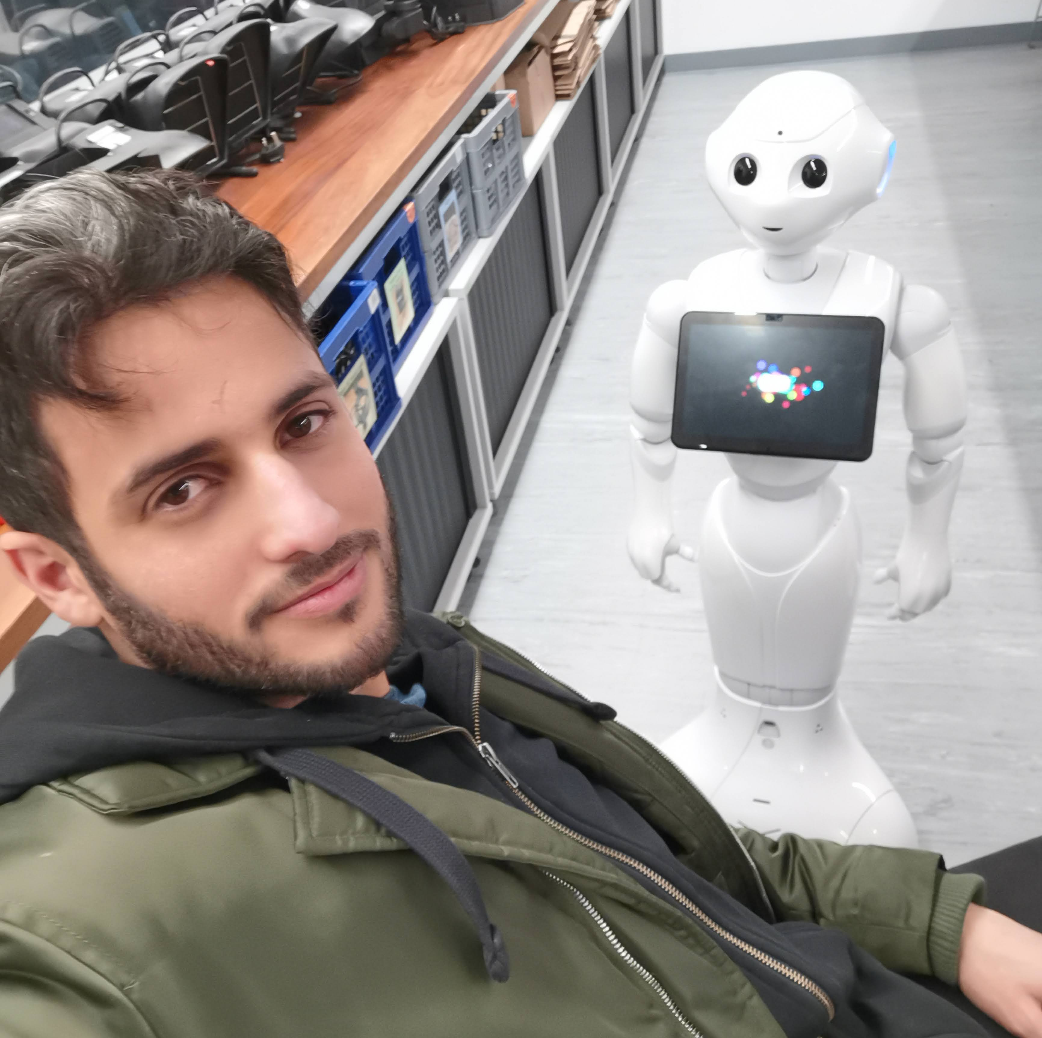
It would be useful in many places if Pepper can read my emotions.

Slide 5
Most of the sentiment work have been done on a single input such as text, or voice.
We applied three to complement each other, face, voice, and text.

Slide 6

The main structure of the project.
Face features
CNN,
Mobile Net V2
Soft-Max
Fusion mapping
Single or mixed emotion
Voice features
LSTM,
Sequential
Soft-Max
Text features
Sentiment intensity analyzer
Soft-Max

Slide 7
Demonstration

Slide 8
Results:
Number of wrong predictions | Face | voice | text | probability | Vote
0 | 0.61 | 0.75 | 0.8 | 0.366 | C
1 | 0.61 | 0.75 | 0.2 | 0.0915 | C
1 | 0.61 | 0.25 | 0.8 | 0.122 | C
1 | 0.39 | 0.75 | 0.8 | 0.234 | C
2 | 0.61 | 0.25 | 0.2 | 0.0305 | N
2 | 0.39 | 0.75 | 0.2 | 0.0585 | N
2 | 0.39 | 0.25 | 0.8 | 0.078 | N
3 | 0.39 | 0.25 | 0.2 | 0.0195 | N
81.35 % accuracy

Slide 9
Thank You

